Slide 1


COFFEE AND
INSTANT DRINKS
Discover new opportunities…
COMPANY AND PRODUCT OFFER PRESENTATION – B2B

Slide 2
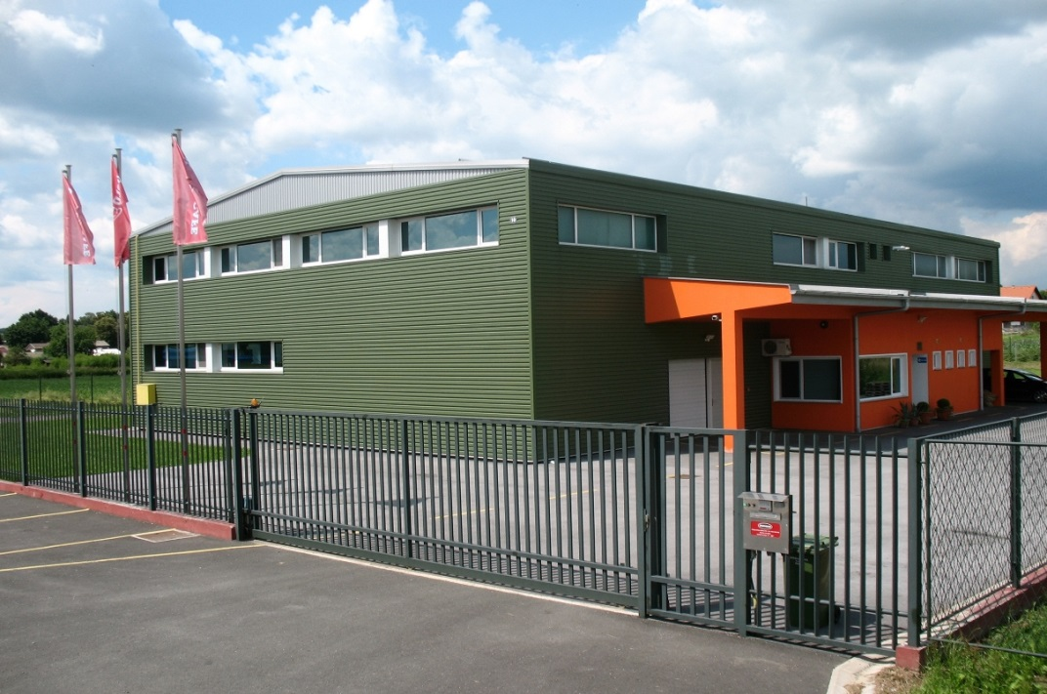
About us
Founded in 1994. as a small family owned coffee roasting company.
In 2005. a new and modern production facility specialized for production of powdered instant drinks was built.
In 2006. HACCP system of quality control was incorporated in the production process which insures high standards of quality and food safety.
In 2018. we are implementing the prestige IFS standard for production of private label products.
OUR MISSION is to make our products meet your expectations with every cup – every day.
OUR QUALITY POLICY is the cornerstone of our business. Ensuring high quality of every product is the guideline and guarantee for our consumers, clients and partners.
‘’Quality is our secret ingredient.’’
Introduction in numbers:
800 m² production facility area
24 years of business
> 20 different products
200 t/annually of coffee and instant coffee drinks produced

Slide 3
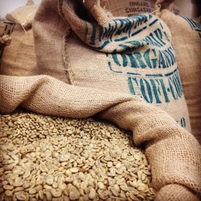
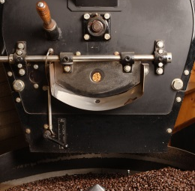
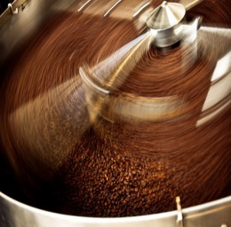
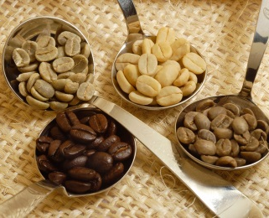
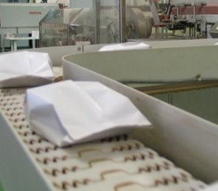
Production process
To produce high quality coffee and instant coffee drinks requires decades of experience, knowledge and love for coffee.
Our company has more than 20 years of experience in the coffee industry and more than 10 years in production of private label products for other companies and clients.
In short, the coffee production process can be described in the following steps:
1.) Selection of raw
materials
2.) Roasting
3.) Blending
4.) Quality control
5.) Packaging
To produce our products we use only the best raw materials from all around the world.
One of the most important production processes during which the coffee gets its characteristic taste and aroma.
Blending different types of coffee and ingredients insures the distinctive taste of all our products.
HACCP and IFS system of quality control ensures high safety standards for our consumers.
Finished products are packaged to ensure freshness and durability of our products.

Slide 4
Product offer B2B and private label
In line with global market trends, our company has introduced private label production in our services portfolio. The main characteristics of PL products are their competitive prices while at the same time, maintaining high quality standards for the consumer.
Our private label product range includes:
ROASTED COFFEE
INSTANT CAPPUCCINO
INSTANT COFFEE
INSTANT COFFEE MIXES ("3in1", "2in1")
COFFEE CREAMER
INSTANT COCOA AND CHOCOLATE DRINKS
BROWN SUGAR (BIO)
INSTANT COFFEE SUBSTITUTES (CEREAL MIXTURES)
COFFEE AND TEA EXTRACTS
INSTANT MIXES FOR BAKERY INDUSTRY
With more than 10 years of experience and knowledge in private label production we guarantee that we
will deliver a shelf-ready product that will meet your expectations, starting from selection of high
quality raw materials up to design and packaging of the finished product.

Slide 5



Roasted coffee
A blend of selected raw coffee beans originating from South America, India and Africa. Blended and traditionally roasted according to our own recipe which insures satisfaction of even the most demanding customers and true coffee connoisseurs.
"A good day starts with a cup of your favorite coffee."
Product details
Packaging solutions

Slide 6
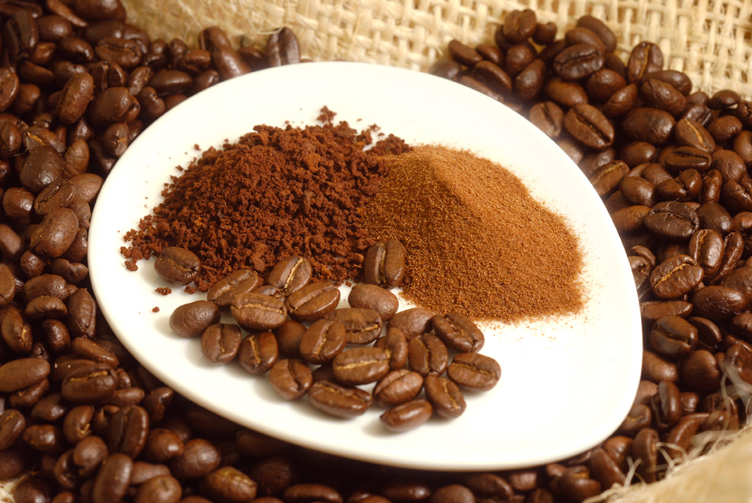
Micro-ground roasted coffee
New and innovative type of coffee grinding technology which insures that the roasted coffee beans are ground into an ultra fine powder under 100 microns of particle size. This insures that the coffee can be prepared only by poring over with hot water in a cup and does not require boiling on the stove like traditionally roasted and ground coffee.
NEW AND INNOVATIVE PRODUCT
ULTRA-FINE GROUND COFFEE (< 100 MICRONS)
CAN BE COMBINED WITH INSTANT COFFEE
Product details
Packaging solutions

Slide 7
Roasted coffee (beans, ground)
Product details
ROASTED COFFEE BEANS | Traditionally roasted coffee (for households) | Arabica and Robusta blend
 | Espresso (for café’s) | 100% Arabica or Arabica and Robusta blend
ROASTED, GROUND COFFEE | Traditionally roasted coffee (for households) | Arabica and Robusta blend / finely ground
 | Turkish coffee blend | Arabica and Robusta blend / finely ground
 | Filter coffee | 100% Arabica or Arabica and Robusta blend / finely or coarsely ground
 | Espresso | 100% Arabica or Arabica and Robusta blend / finely or coarsely ground
 | Micro – ground coffee | New and innovative type of coffee grinding technology which insures that the roasted coffee beans are ground into an ultra fine powder under 100 microns of particle size. This insures that the coffee can be prepared only by poring over with hot water in a cup and does not require boiling on the stove like traditionally roasted and ground coffee.

Slide 8
Roasted coffee (beans, ground)
Packaging solutions
 | Primary packaging | Secondary packaging |  | Transport packaging |  | Other packaging types
 |  | Net weight | Packaging type | Units per carton | Units per pallet | SRP* | Zipper (open / close) | Other
ROASTED, GROUND COFFEE | 100 g bag | 5.000 g | Carton box | 50 | 4.500 |  | O | O
 | 200 g bag | 4.000 g | Carton box | 20 | 1.800 |  | O | O
 | 250 g bag | 5.000 g | Carton box | 20 | 1.800 |  | X | O
 | 400 g bag | 4.000 g | Carton box | 10 | 900 |  | X | O
 | 500 g bag | 5.000 g | Carton box | 10 | 900 |  | X | O
 | Industry packaging | 25 kg | Bulk carton | 1 | 12 | X | X | O
ROASTED COFFEE BEANS | 250 g bag | 5.000 g | Carton box | 20 | 1.800 |  | X | O
 | 500 g bag | 5.000 g | Carton box | 10 | 900 |  | X | O
 | 1.000 g bag | 6.000 g | Carton box | 6 | 540 |  | X | O
- available ; O – on request ; X – not available
* SRP (Shelf Ready Packaging)

Slide 9

Instant Cappuccino
Our cappuccino is made for true coffee connoisseurs.
Full-bodied flavor combined with a discrete taste of coffee will make all your senses enjoy this delicious hot beverage.
Product details
Packaging solutions

Slide 10
Instant Cappuccino
Product details
 |  | Gluten free | Lactose free | Caffeine free
INSTANT CAPPUCCINO | Classic | O | O | O
 | Chocolate | O | O | O
 | Vanilla | O | O | O
 | Irish Cream | O | O | O
 | Other on request | Light (less sugar), Hazelnut, Nougat, Rum, Caramel, Cafe Mocha, Coconut,…
- available ; O - on request

Slide 11
Instant Cappuccino – Packaging
Packaging solutions
 | Primary packaging | Secondary packaging |  | Transport packaging |  | Other packaging types
 |  | Net weight | Packaging type | Units per carton | Units per pallet | SRP* | Zipper (open / close) | Other
INSTANT CAPPUCCINO | 18 g stick-pack | 540 g | 30/1 display box | 30 | 19.950 |  | X | O
 |  | 3.600 g | Carton box | 200 | 18.000 | X | X | O
 | 100 g doypack | 3.000 g | Carton box | 30 | 2.700 |  |  | O
 | 200 g bag | 3.000 g | Carton box | 15 | 1.350 |  | O | O
 | 250 g bag | 3.000 g | Carton box | 12 | 1.080 |  | X | O
 | Industry packaging | 1 kg bag | Carton box | 6 | 540 | X | X | O
 |  | 25 kg box | PE + bulk carton | 1 | 12 | X | X | O
- available ; O – on request ; X – not available
* SRP (Shelf Ready Packaging)

Slide 12

Instant Cappuccino for vending machines
Instant cappuccino is a delicious hot beverage made from high quality instant coffee, creamer and sugar topped with a rich milky foam and discrete coffee taste. It is specially developed for preparation in vending machines and available in a wide range of flavors such as chocolate, vanilla, Irish cream and many others that will satisfy even the most demanding customers and true coffee connoisseurs.
Product details
Packaging solutions

Slide 13
Instant Cappuccino for vending machines
Product details
 |  | Gluten free | Lactose free | Caffeine free
VENDING INSTANT CAPPUCCINO | Cappuccino base with instant coffee | O | O | O
 | Cappuccino base without instant coffee (for machines that use espresso coffee) | O | O
 | Flavors | Classic. Chocolate, Vanilla, Irish Cream, Light (less sugar), Hazelnut, Nougat, Rum, Caramel, Cafe Mocha,…
Packaging solutions
 | Primary packaging | Secondary packaging |  | Transport packaging |  | Other packaging types
 |  | Net weight | Packaging type | Units per carton | Units per pallet | SRP* | Zipper (open / close) | Other
VENDING INSTANT CAPPUCCINO | 500 g bag | 5.000 g | Carton box | 10 | 900 |  | X | O
 | 1.000 g bag | 6.000 g | Carton box | 6 | 540 | X | X | O
 | Industry packaging | 1 kg bag | Carton box | 6 | 540 | X | X | O
 |  | 25 kg box | PE + bulk carton | 1 | 12 | X | X | O
- available ; O – on request

Slide 14

Instant coffee
100 % soluble coffee extract powder made from high quality roasted coffee originating from South America and India.
Wake up to an intense aroma of our instant coffee selection.
Product details
Packaging solutions

Slide 15
Instant Coffee
Product details
 | Blend | Gluten free | Caffeine free
INSTANT COFFEE | Classic | O | X
 | Strong | O | X
 | Flavored (with aroma) | O | X
 | Flavors: Chocolate, Rum, Hazelnut, Vanilla, Irish Cream
 | Type | Available
INSTANT COFFEE | Spray-dried
 | Agglomerated | O
 | Freeze-dried | O
- available ; O – on request ; X – not available

Slide 16
Instant coffee – Packaging
Packaging solutions
 | Primary packaging | Secondary packaging |  | Transport packaging |  | Other packaging types
 |  | Net weight | Packaging type | Units per carton | Units per pallet | SRP* | Zipper (open / close) | Other
INSTANT COFFEE | 2 g stick-pack | 160 g | 80/1 display box | 80 | 53.200 |  | X | O
 |  | 1.000 g | Carton box | 500 | 45.000 | X | X | O
 | 75 g doypack | 1.500 g | Carton box | 20 | 1.800 |  |  | O
 | 100 g doypack | 2.000 g | Carton box | 20 | 1.800 |  |  | O
 | 150 g doypack | 2.250 g | Carton box | 15 | 1.350 |  |  | O
 | 200 g doypack / bag | 3.000 g | Carton box | 15 | 1.350 |  |  | O
 | Industry packaging | 1 kg bag | Carton box | 6 | 540 | X | X | O
 |  | 25 kg box | PE + bulk carton | 1 | 12 | X | X | O
- available ; O – on request ; X – not available
* SRP (Shelf Ready Packaging)

Slide 17

Instant coffee mixes
2in1
Our instant coffee mix is the perfect blend of high quality instant coffee and delicious creamy milk made 2 GO! Its practical packaging ensures a quick and easy preparation so you can enjoy it at any time of the day whether you are on work or on the road.
3in1
3in1+
Product details
Packaging solutions
Caffe Latte

Slide 18
Instant coffee mixes
Product details
 |  | Gluten free | Lactose free | Caffeine free
2in1 | Classic | O | O | O
 | Gluten free |  | O | O
 | Caffe Latte (sweetened) |  | O | O
3in1 | Classic | O | O | O
 | Brown Sugar |  | O | O
3in1+ | Latte | O | O | O
 | Strong | O | O | O
 | Flavored (with aroma) | O | O | O
 |  | Chocolate, Nougat, Vanilla, Caramel, Rum or other on request.
 | Functional (with extracts) | O | O | O
 |  | Green coffee, Cocoa, Ginseng or other.
- available ; O – on request

Slide 19
Instant coffee mix – Packaging
Packaging solutions
 | Primary packaging | Secondary packaging |  | Transport packaging |  | Other packaging types
 |  | Net weight | Packaging type | Units per carton | Units per pallet | SRP* | Other
2 IN 1 / Caffe Latte INSTANT COFFEE MIX | 10 g stick-pack | 50 g | 5/1 multipack bag | 30 | 2.700 | O | O
 |  | 350 g | 35/1 display box | 35 | 23.275 |  | O
 |  | 2.700 g | Carton box | 270 | 24.300 | X | O
 | Industry packaging | 1 kg bag | Carton box | 6 | 540 | X | X
 |  | 25 kg box | PE + bulk carton | 1 | 12 | X | X
 | Primary packaging | Secondary packaging |  | Transport packaging |  | Other packaging types
 |  | Net weight | Packaging type | Units per carton | Units per pallet | SRP* | Other
3 IN 1 INSTANT COFFEE MIX | 15 g stick-pack | 75 g | 5/1 multipack bag | 30 | 2.700 | O | O
 |  | 525 g | 35/1 display box | 35 | 23.275 |  | O
 |  | 4.050 g | Carton box | 270 | 24.300 | X | O
 | Industry packaging | 1 kg bag | Carton box | 6 | 540 | X | X
 |  | 25 kg box | PE + bulk carton | 1 | 12 | X | X
- available ; O – on request ; X – not available
* SRP (Shelf Ready Packaging)

Slide 20

Functional instant coffee mixes
GREEN CAFFE ®
a unique blend of high quality instant coffee and green coffee bean extract with minimal of 45 % Chlorogenic acid rich in antioxidants and fiber. Just empty the conveniently packaged single-serving sachet in a cup and pour over with hot water and enjoy.
Product details
Packaging solutions
No added sugars
Enriched with green coffee extract '‘Caffea arabica''
(min. 45% chlorogenic acid)
Rich in antioxidants
High fiber content
Great taste of high quality instant coffee

Slide 21
Functional instant coffee mixes
Packaging solutions
 | Primary packaging | Secondary packaging |  | Transport packaging |  | Other packaging types
 |  | Net weight | Packaging type | Units per carton | Units per pallet | SRP* | Other
GREEN CAFFE INSTANT COFFEE | 2,5 g stick-pack | 200 g | 80/1 display box | 80 | 53.200 |  | O
 |  | 1.250 g | Carton box | 500 | 45.000 | X | O
 | 50 g box 20/1 | 50 g | Box (20 servings) | 14 | 1.260 | O | O
 | Industry packaging | 1 kg bag | Carton box | 6 | 540 | X | X
 |  | 25 kg box | PE + bulk carton | 1 | 12 | X | X
- available ; O – on request ; X – not available
* SRP (Shelf Ready Packaging)

Slide 22

Instant coffee substitutes
100 % soluble product made from a blend of roasted cereals that imitate roasted coffee flavor and aroma. Since they do not contain caffeine and are rich in natural fiber they represent a healthy alternative to classical roasted and instant coffee.
Instant (100 % soluble)
Caffeine free
No added sugars
Rich in fiber
Suitable for vegetarians
Delicious substitute for instant coffee based drinks: 1 in 1, 2 in 1, 3 in 1,…
Product details
Packaging solutions

Slide 23
Instant coffee substitutes
Product details
 | Added sugar | Caffeine free | Gluten free | Lactose free
"ORZO" 100 % INSTANT COFFEE SUBSTITUTE | X |  | O | O
"ORZO 2 IN 1" INSTANT CEREAL MIX | X |  | O | O
"ORZO 3 IN 1" INSTANT CEREAL MIX |  |  | O | O
- available ; O – on request ; X – not available

Slide 24
Instant coffee substitutes – Packaging
Packaging solutions
 | Primary packaging | Secondary packaging |  | Transport packaging |  | Other packaging types
 |  | Net weight | Packaging type | Units per carton | Units per pallet | SRP* | Zipper (open / close) | Other
"ORZO" 100 % INSTANT COFFEE SUBSTITUTE | 4 g stick-pack | 320 g | 80/1 display box | 80 | 53.200 |  | X | O
 |  | 2.000 g | Carton box | 500 | 45.000 | X | X | O
 | 100 g doypack | 3.000 g | Carton box | 30 | 2.700 |  |  | O
 | Industry packaging | 13 kg | Bulk bag | 1 | 30 | X | X | O
"ORZO 2 IN 1" INSTANT CEREAL MIX | 15 g stick-pack | 450 g | 30/1 display box | 30 | 19.950 |  | X | O
 | Industry packaging | 25 kg | Bulk carton | 1 | 12 | X | X | O
"ORZO 3 IN 1" INSTANT CEREAL MIX | 18 g stick-pack | 540 g | 30/1 display box | 30 | 19.950 |  | X | O
 | Industry packaging | 25 kg | Bulk carton | 1 | 12 | X | X | O
- available ; O – on request ; X – not available
* SRP (Shelf Ready Packaging)

Slide 25
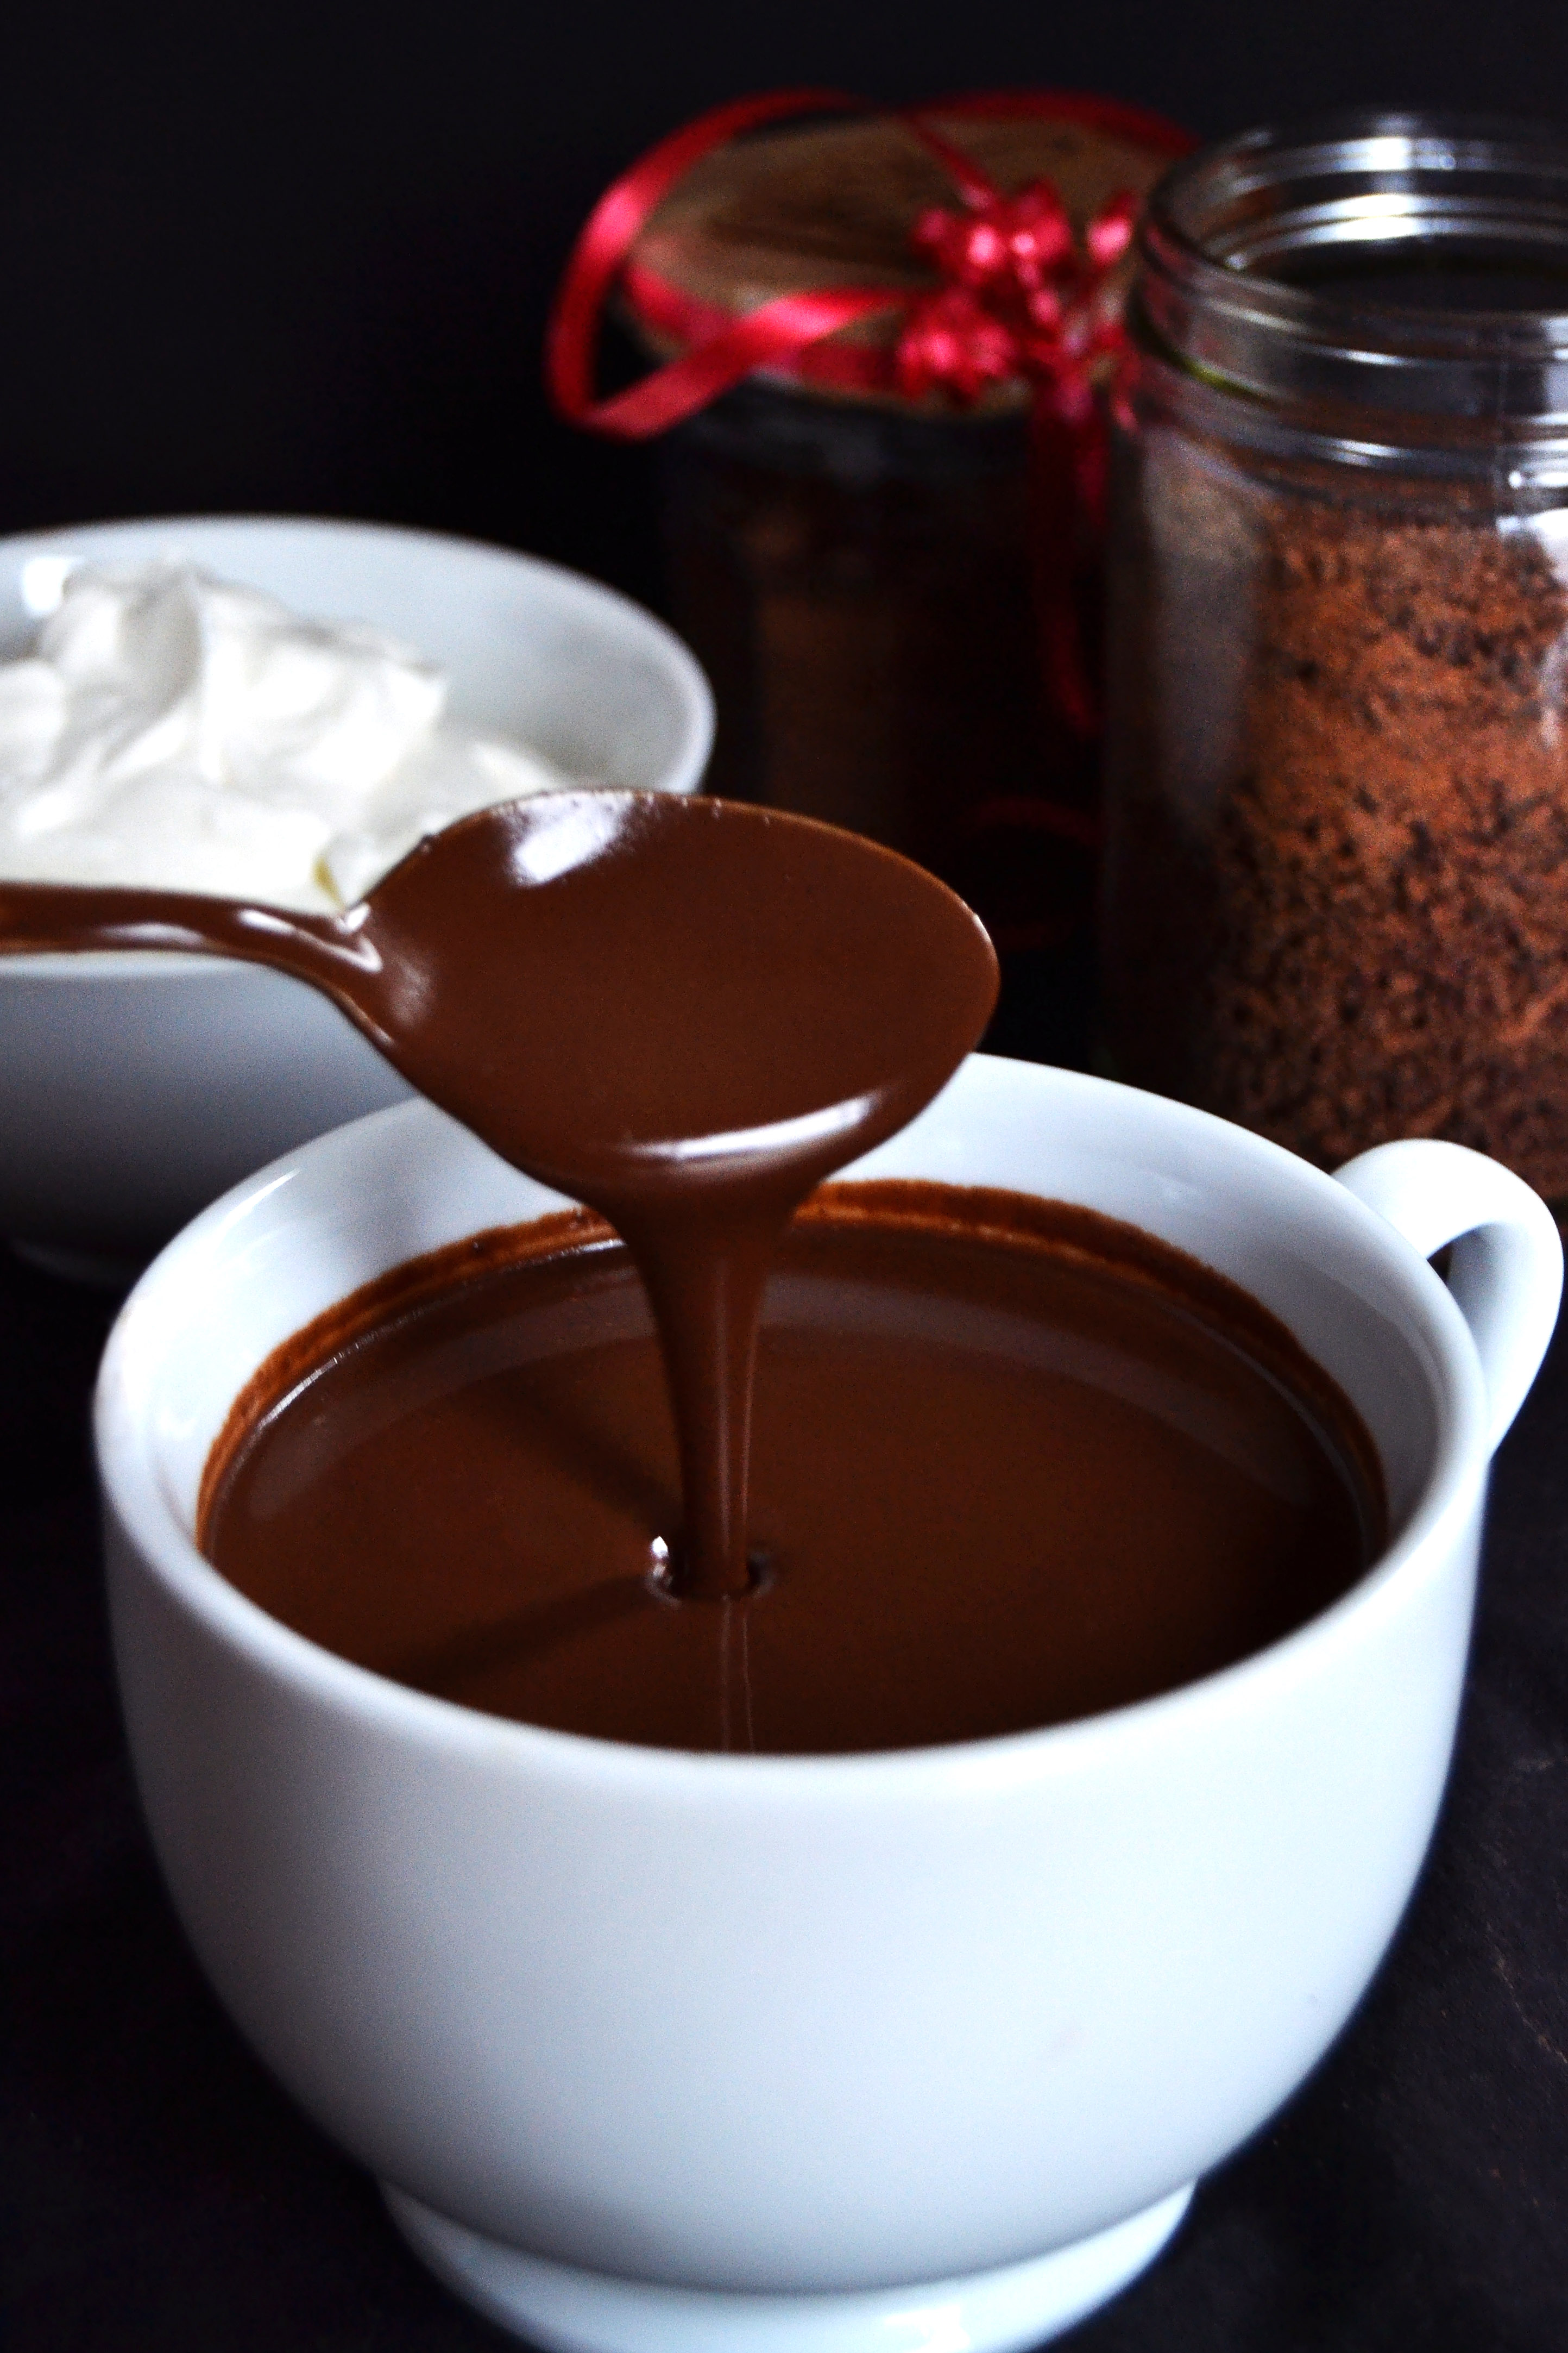
Instant cocoa and chocolate drinks
Hot chocolate is a delicious mix of high quality cocoa powder, sugar, chocolate and thickening agent in ratios depending on the style of preparation. The drink can be prepared with hot water or with milk.
      Delicious & thick chocolate drink
      Gluten free
      Caffeine free
Product details
Packaging solutions

Slide 26
Instant cocoa and chocolate drinks
Product details
 | Prepared with water | Prepared with milk | Gluten free | Lactose free | Caffeine free
INSTANT COCOA DRINK |  | X |  | O
INSTANT CHOCOLATE DRINK – HOT CHOCOLATE | X
- available ; O – on request ; X – not available

Slide 27
Instant cocoa and chocolate drinks
Packaging solutions
 | Primary packaging | Secondary packaging |  | Transport packaging |  | Other packaging types
 |  | Net weight | Packaging type | Units per carton | Units per pallet | SRP* | Zipper (open / close) | Other
INSTANT COCOA AND CHOCOLATE DRINKS | 25 g stick-pack | 750 g | 30/1 display box | 30 | 19.950 |  | X | O
 |  | 5.000 g | Carton box | 200 | 18.000 | X | X | O
 | 100 g doypack | 3.000 g | Carton box | 30 | 2.700 |  |  | O
 | 200 g bag | 3.000 g | Carton box | 15 | 1.350 |  | X | O
 | 250 g bag | 3.000 g | Carton box | 12 | 1.080 |  | X | O
 | Industry packaging | 1 kg bag | Carton box | 6 | 540 | X | X | O
 |  | 25 kg box | PE + bulk carton | 1 | 12 | X | X | O
- available ; O – on request ; X – not available
* SRP (Shelf Ready Packaging)

Slide 28
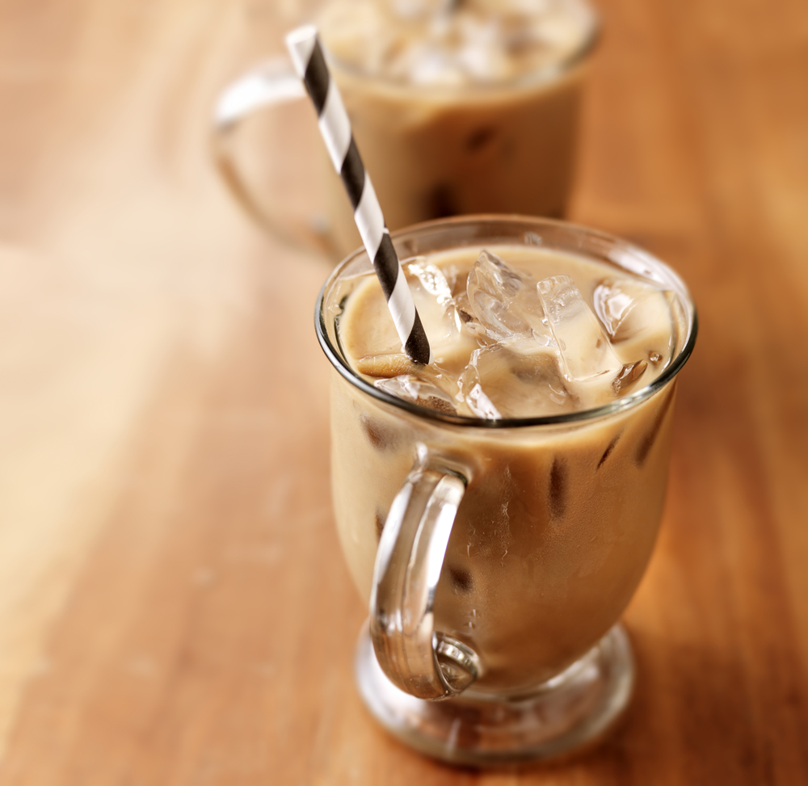
Instant Ice Coffee
ICE COFFEE is a summer time refreshing and delicious cold beverage in which you can enjoy whether you are at home, on the road or under a sunshade on the beach. The perfect combination of lightly sweetened cafe latté will make you enjoy every sip.
Just empty the conveniently packaged single-serving sachet in a cup and pour over with cold water or milk.
100 % soluble in cold water or milk
Gluten free
Two types: ice coffee or ice frappe formula
Product details
Packaging solutions

Slide 29
Instant Ice Coffee – Packaging
Packaging solutions
 | Primary packaging | Secondary packaging |  | Transport packaging |  | Other packaging types
 |  | Net weight | Packaging type | Units per carton | Units per pallet | SRP* | Other
INSTANT ICE COFFEE | 15 g stick-pack | 450 g | Display box | 30 | 19.950 |  | O
 |  | 4.050 g | Carton box | 270 | 24.300 | X | O
 | Industry packaging | 1 kg bag | Bulk carton | 6 | 540 | X | O
 |  | 25 kg box | Bulk carton | 1 | 12 | X | O
INSTANT ICE FRAPPE Available flavors: Ice coffee Cherry Strawberry Rum & Coconut Forest fruit Tropical | 20 - 25 g stick-pack | 540 g | Display box | 30 | 19.950 |  | O
 |  | 3.600 g | Carton box | 200 | 18.000 | X | O
 | Industry packaging | 1 kg bag | Bulk carton | 6 | 540 | X | O
 |  | 25 kg box | Bulk carton | 1 | 12 | X | O
- available ; O – on request ; X – not available
* SRP (Shelf Ready Packaging)

Slide 30
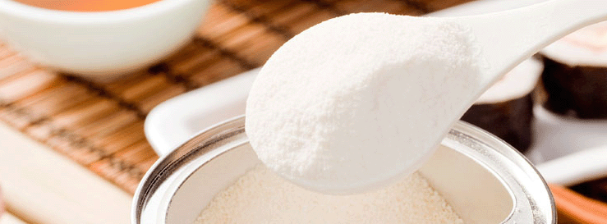
Coffee Creamer – Coffee Whitener
Is a complete non-dairy substitute for milk based on vegetable ingredients. It can be used in coffee, cocoa, tea drinks and soups to enrich flavor and add creaminess to the drink without cooling it. It has a wide range of uses in vending machines, product mixtures and can also be packaged in single serving sachets for restaurants, cafes or home use.
    100 % soluble (spray-dried powder)
    Low fat content
    Suitable for vegetarians (vegetable based)
    Gluten free
Product details
Packaging solutions

Slide 31
Coffee Creamer – Packaging
Packaging solutions
 | Primary packaging | Secondary packaging |  | Transport packaging |  | Other packaging types
 |  | Net weight | Packaging type | Units per carton | Units per pallet | SRP* | Zipper (open / close) | Other
COFFEE CREAMER | 3 g stick-pack | 240 g | 80/1 display box | 80 | 53.200 |  | X | O
 |  | 1.500 g | Carton box | 500 | 45.000 | X | X | O
 | 100 g doypack | 3.000 g | Carton box | 30 | 2.700 |  |  | O
 | 150 g doypack | 3.000 g | Carton box | 20 | 1.800 |  |  | O
 | 200 g doypack / bag | 3.000 g | Carton box | 15 | 1.350 |  |  | O
 | 250 g bag | 3.000 g | Carton box | 12 | 1.080 |  | X | O
 | 500 g bag | 3.000 g | Carton box | 6 | 540 |  | X | O
 | Industry packaging | 1 kg bag | Carton box | 6 | 540 | X | X | O
 |  | 25 kg box | PE + bulk carton | 1 | 12 | X | X | O
- available ; O – on request ; X – not available
* SRP (Shelf Ready Packaging)

Slide 32
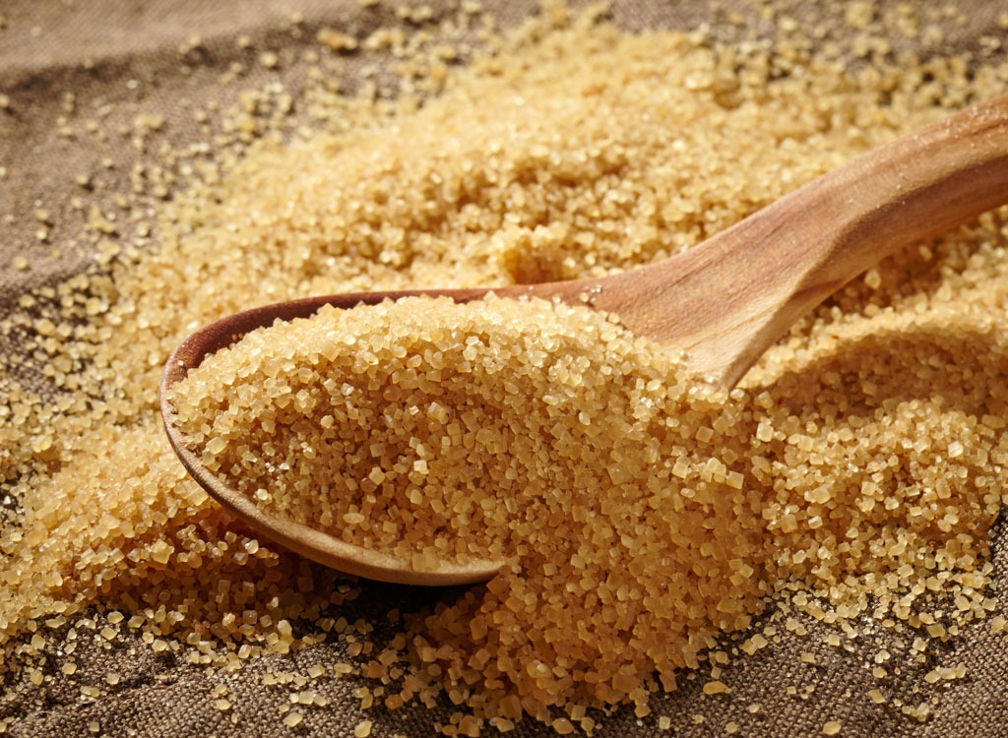

Brown Demerara sugar
Demerara is a high quality brown sugar for everyday household use and industry. It is used to prepare meals, drinks and sweets that require a full and caramel like taste and aroma.
Unrefined ''Demerara'' sugar is made from 100% natural sugar cane juice to save all of the special aromas and flavors that define this type of sugar.
The sugar crystals are golden in color, crunchy in texture and with a mild sugar cane molasses flavor.
No colors or additives used
No ionizing radiation used
Non-GMO
Gluten free
Available as ORGANIC / BIO certified*
Product details
Packaging solutions

Slide 33
Brown Demerara sugar
Packaging solutions
 | Primary packaging | Secondary packaging |  | Transport packaging |  | Other packaging types
 |  | Net weight | Packaging type | Units per carton | Units per pallet | SRP* | Zipper (open / close) | Other
BROWN SUGAR | 4 g stick-pack | 4.000 g | Carton box | 1.000 | 90.000 | O | X | O
 | Industry packaging | 25 kg | Bulk bag | 1 | 40 | X | X | O
 | Primary packaging | Secondary packaging |  | Transport packaging |  | Other packaging types
 |  | Net weight | Packaging type | Units per carton | Units per pallet | SRP* | Zipper (open / close) | Other
ORGANIC BROWN SUGAR | 3 g stick-pack | 3.000 g | Carton box | 1.000 | 90.000 | O | X | O
 | 400 g bag | 6.000 g | Carton box | 15 | 1.350 | O | X | O
 | 750 g bag | 6.000 g | Carton box | 8 | 720 | O | X | O
 | 1.000 g bag | 6.000 g | Carton box | 6 | 540 | O | X | O
 | Industry packaging | 25 kg | Bulk bag | 1 | 40 | X | X | O
- available ; O – on request ; X – not available
* SRP (Shelf Ready Packaging)

Slide 34
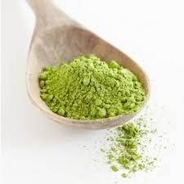
Coffee and Tea extracts
GREEN COFFEE EXTRACT
is an extract of unroasted, green coffee beans in powder form standardized to contain min. 45% of Chlorogenic acids or GCA that act a natural antioxidant and are used as an ingredient for nutritional and health products.
GREEN TEA EXTRACT
Is an extract of high quality green tea leaves (Camellia sinensis) in powder form which contain standardized amount of Polyphenols, Catechins and EGCG as active ingredients.
The product is used as a natural antioxidant and an ingredient for nutritional and health products.
Product details
Packaging solutions

Slide 35
Coffee and Tea extracts
Product details
 | Available types:
GREEN COFFEE EXTRACT | - 100 % pure Green Coffee extract (Coffea Arabica) min. 45 % chlorogenic acids - Combination of green coffee extract and instant coffee
GREEN TEA EXTRACT | - 45% of Polyphenols and 10% EGCG - 90% of Polyphenols and 50% EGCG
 | Primary packaging | Secondary packaging |  | Transport packaging |  | Other packaging types
 |  | Net weight | Packaging type | Units per carton | Units per pallet | SRP* | Zipper (open / close) | Other
GREEN COFFEE EXTRACT | Industry packaging | 25 kg | Bulk carton | 1 | 12 | X | X | O
GREEN TEA EXTRACT | Industry packaging | 25 kg | Bulk carton | 1 | 12 | X | X | O
Packaging solutions
- available ; O – on request ; X – not available
* SRP (Shelf Ready Packaging)

Slide 36
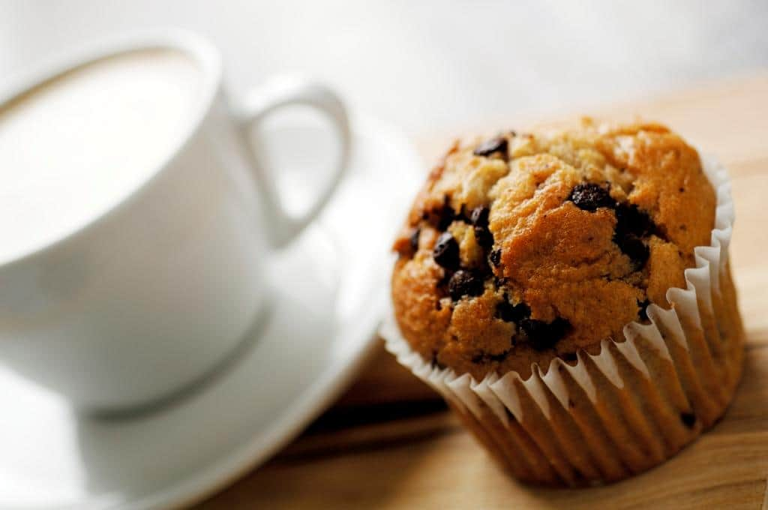
Instant bakery mixes
What goes best with a cup of coffee? Delicious cakes of course!
Try our new range of instant bakery mixes for sponge cake, muffins, pancakes and macarons which will turn you into a profesional baker in just a few minutes.
Our bakery mixes insure:
Perfect result every time,
Standardized production,
Time and money saving proccess.
Products: Muffin mix, Pancake mix, Sponge cake mix, Macaron mix and many more…
Product details
Packaging solutions

Slide 37
Instant bakery mixes
Product details
 |  | Add water | Add oil | Add fresh eggs | Baking time
MUFFIN (CREAM CAKE) MIX | Preparation: |  |  |  | 18 min
 | Flavors: | Classic, chocolate, vanilla, caramel, coconut, with added protein, with added dried fruits, other on request.
SPONGE CAKE / SWISS ROLL MIX | Preparation: |  | X |  | 20 min
 | Flavors: | Classic, Chocolate, other on request.
PANCAKE (CRÊPE) MIX | Preparation: |  | X | X | 1 min
 | Flavors: | Classic, buckwheat, chocolate, with added protein, other on request.
MACARON MIX | Preparation: |  | X | X | 20 min

Slide 38
Instant bakery mixes
Packaging solutions
 | Primary packaging |  | Secondary packaging |  |  | Other packaging types
 | Type | Net weight | Packaging type | Units per carton | Units per pallet | SRP* | Zipper (open / close) | Other
MUFFIN (CREAM CAKE) MIX SPONGE CAKE / SWISS ROLL MIX | Retail | 300 g PE bucket | Carton box | 6 | 540 |  | X | O
 |  | 3 kg | Bag | 2 | 180 | X | X | O
 | Industry packaging | 12.5 kg | Bag | - | 80 | X | X | O
 |  | 25 kg | Bag | - | 40 | X | X | O
PANCAKE MIX | Retail | 250 g bag | Carton box | 12 | 1.080 |  |  | O
 |  | 3 kg | Bag | 2 | 180 | X | X | O
 | Industry packaging | 12.5 kg | Bag | - | 80 | X | X | O
 |  | 25 kg | Bag | - | 40 | X | X | O
MACARON MIX | Retail | 500 g bag | Bag | 10 | 900 | X | X | O
 |  | 3 kg | Bag | 2 | 180 | X | X | O
 | Industry packaging | 12.5 kg | Bag | - | 80 | X | X | O
- available ; O – on request ; X – not available
* SRP (Shelf Ready Packaging)

Slide 39


Contact
PROMIGO D.O.O.
Poslovna zona 1/10, HR-44320 Kutina
Hrvatska / Croatia
Tel: +385 (98) 952 - 1668
Fax: +385 (44) 625 - 969
Email: promigo@promigo.eu
www.fino-caffe.hr
www.promigo.eu

